Slide 1
CS50 Lab 4 Andrew Holmes

Slide 2
Useful info
Tutorial time
5-6pm Pfoho dhall (can be hybrid, email me if needed)
Email
aholmes@college.harvard.edu
Slack
Now created – please join, this will be best way to reach me if needed and I will post announcements/info there.

Slide 3
Today’s Logistics
Topic review: images
Lab problem - smiley
Topic review: pointers & files
Lab problem - volume

Slide 4
Topic review: images
Hexadecimal: base 16 (0 – f)
Prefixed by 0x
How to represent a pixel?
typedef struct{
BYTE rgbtBlue;
BYTE rgbtGreen;
BYTE rgbtRed;
} RGBTRIPLE;

Slide 5
Lab problem: smiley (filter practice)
Create a colorful face! (Hopefully less demonic than mine!
https://cs50.harvard.edu/college/2022/fall/labs/4/
https://coolors.co/generate

Slide 6
Topic review: Pointers
What is a pointer?
A variable that stores the address of another object/variable
Type* var gives a variable that stores an address of a variable of type Type

Slide 7
Pointer operations?
The dereference operator: *
Finding the address of a variable: &
int num = 5;
int* addr = &num;
printf(“%i”, *addr);

Slide 8
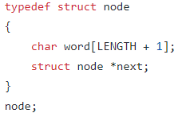
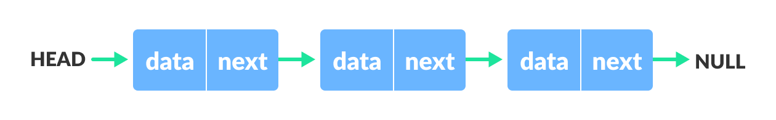
Why do we need pointers?
Use things already stored in memory
Linked lists & other data structures (next week!)

Slide 9
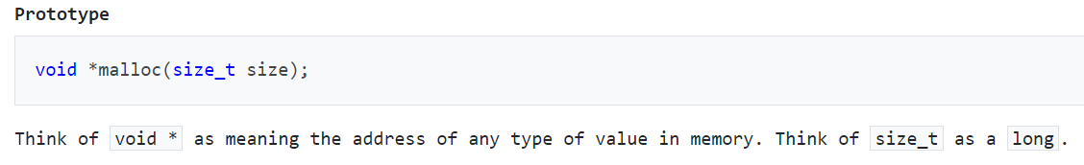
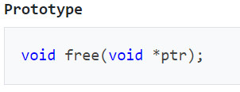
Malloc and free
ALWAYS FREE ANY MEMORY YOU MALLOC

Slide 10
Topic review: Files
New data type: FILE (requires stdio.h)
Let’s examine how some of these functions work:
https://manual.cs50.io/3/fread
https://manual.cs50.io/3/fwrite
Needed for reverse:
https://www.tutorialspoint.com/c_standard_library/c_function_fseek.htm

Slide 11

Example
What is happening in this code?
Why do I not need to pass &header as the first argument?
A: when we store an array variable, our variable is actually a pointer to the first location in the array

Slide 12
Lab problem: Volume
Change the volume of a sound file!
https://cs50.harvard.edu/college/2022/fall/labs/4/

Slide 13
PSET 4 pointers
ALL:
Start early if you can, generally one of the most demanding PSETS
Filter
The harder and easier versions are the same up until the final function, the final function of filter is harder. Consider which functions are destructive -> may need a second image for output
Recover
Use the CS50 manual pages for sprintf, or last year’s walkthrough video (here)
Reverse
Remember that fread moves the pointer in your file: if you want to move backwards a byte after reading a byte, you need to actually fseek back 2 bytes
Easier than recover in my opinion

Slide 14

Cya next week :D

